Slide 1
Big Data Project :
Ocean Warming
Carlos Freiji
Dhia Znaidi
Rayen Ben Ismail
Lucas Ye

Slide 2
Content
Background
Ocean Heat Content (OHC)
Regression
Conclusion

Slide 3
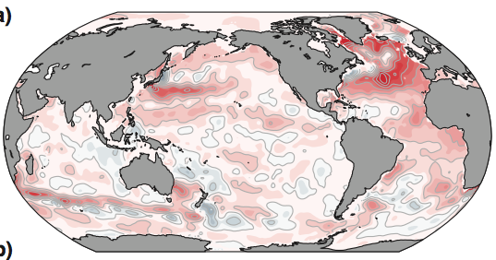
Overview
Because of the greenhouse effect, ocean is warming.
In this project, we calculate the Ocean Heat Content using the sea temperature recorded from 1950 to 2019.
And then, we estimate the trend with the result of regression.

Slide 4

Background
The warming of the oceans has accounted for approximately 93 % of the warming of the Earth since the 1950s. Warming of the upper (0–700 m) ocean accounted for about 64 % of the total heat uptake.
A trend for increasing heat content in the upper ocean has become evident since the 1950s. Recent observations also show substantial warming of the deeper ocean (between depths of 700 and 2 000 m and below 3 000 m).
Ocean heat content (OHC) is a measure of the amount of heat stored in the ocean. It is an important indicator of climate change because the ocean absorbs more than 90% of the heat added to the Earth's system by human activities. An increase in OHC can lead to changes in ocean circulation, sea level, and weather patterns, and can also have impacts on marine ecosystems.

Slide 5
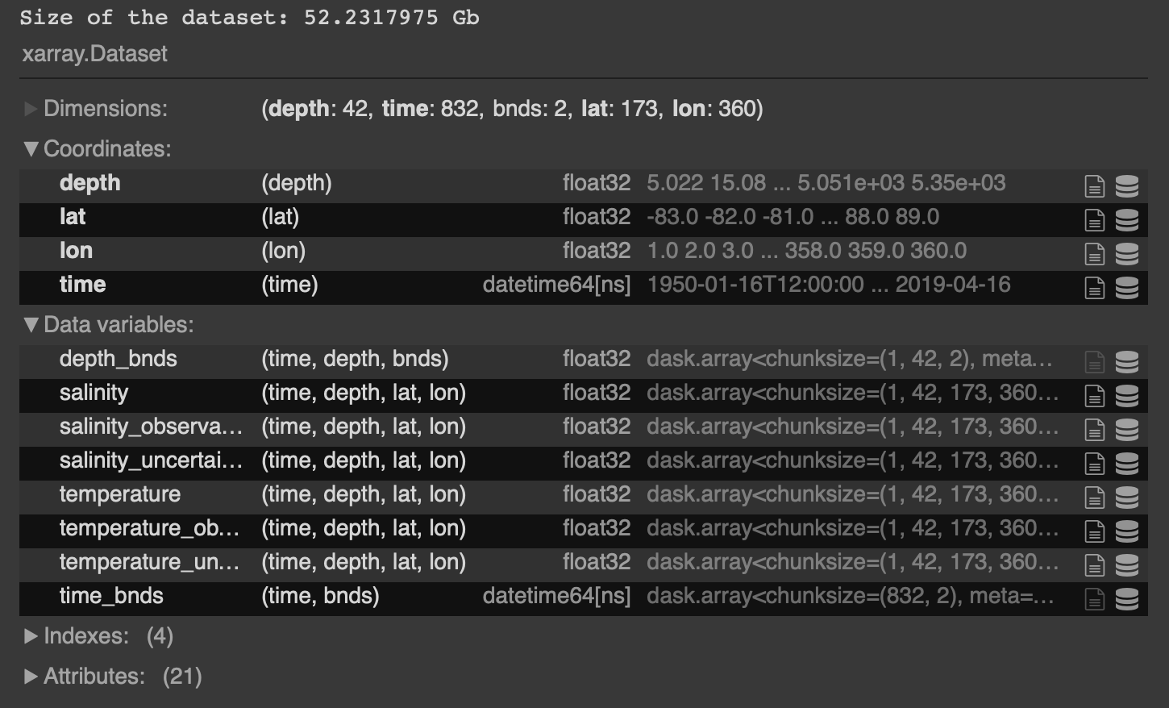
Background - Dataset

Slide 6
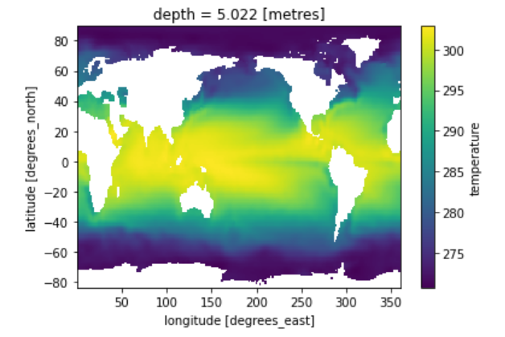
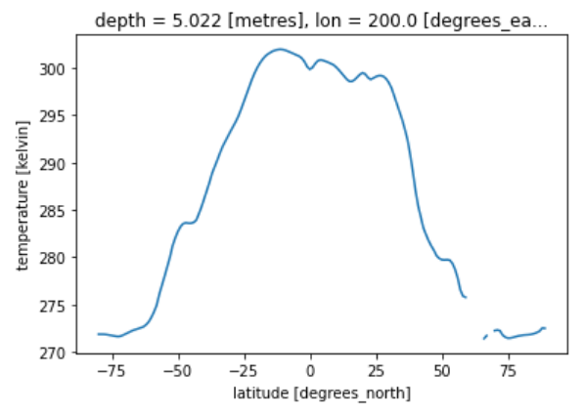
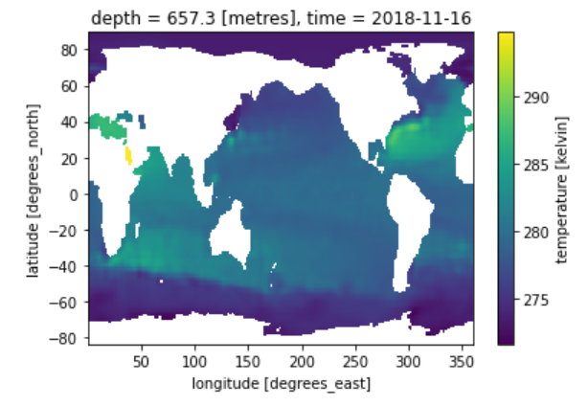
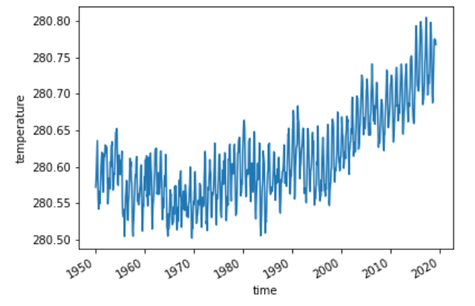
Background - Dataset

Slide 7
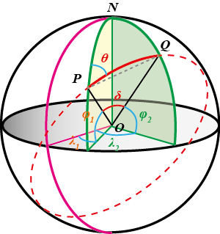
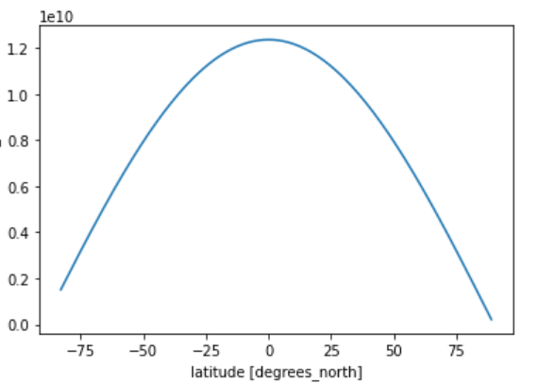

Ocean Heat Content (OHC)
OHC(x,y,z,t) = ρ · Cp · dV(x,y,z) · T(x,y,z,t)
dV(x,y,z) = dA(x,y) · dH(z)
dA(x,y) = R^2 ⋅ dϕ ⋅ dλ ⋅ cos(lat[rad])
dϕ = dλ = np.deg2rad(1.)

Slide 8
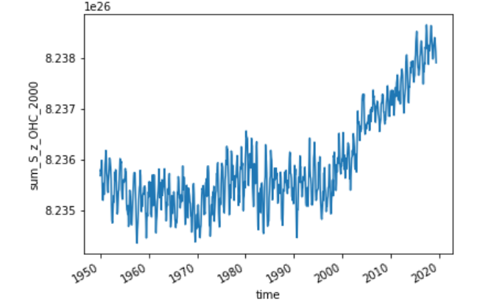
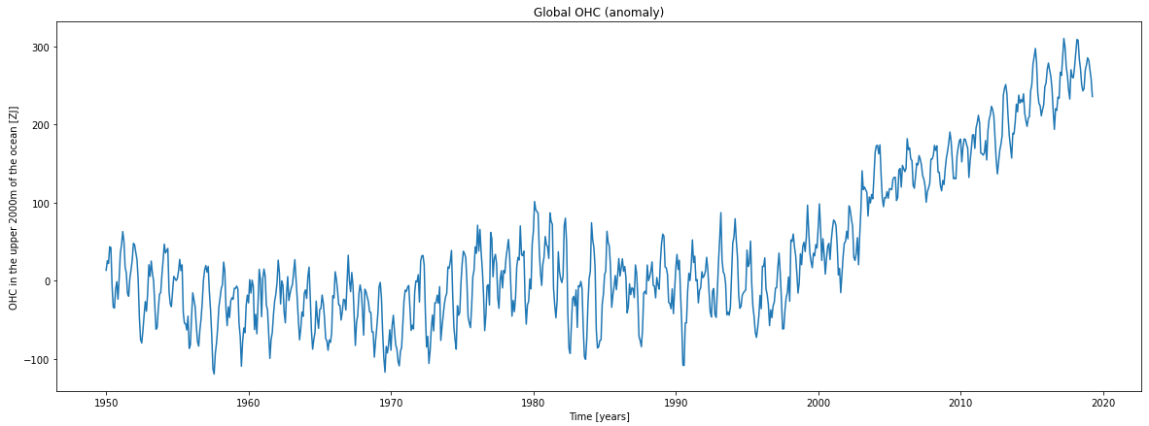
Ocean Heat Content (OHC)
Global OHC
(1950-2019)

Slide 9
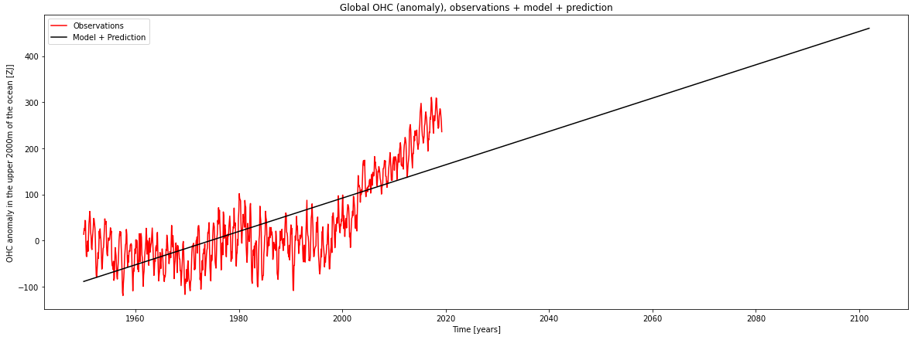
Regression Models : Linear regression

Slide 10
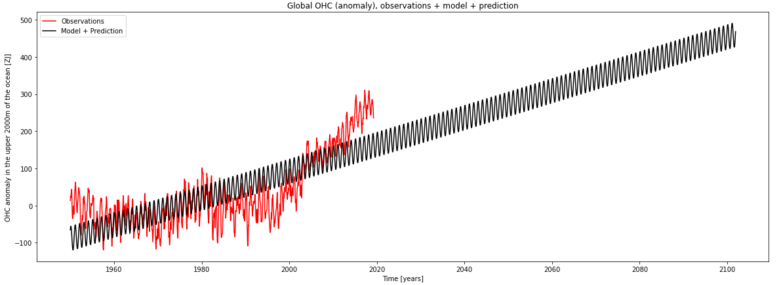
Adding new features : cos and sin (seasons)

Slide 11
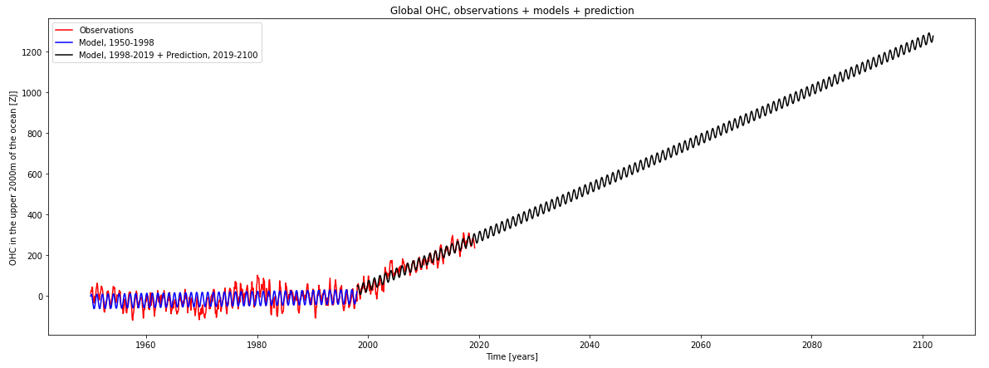
Linear regression - dataset separation

Slide 12
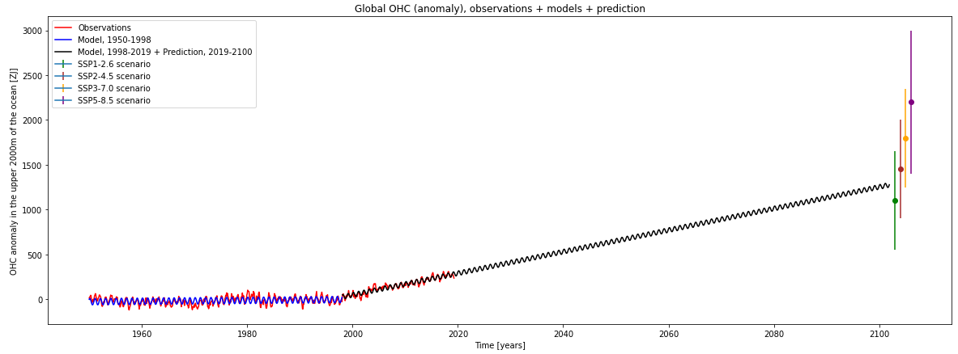
Linear regression - dataset separation
Comparison with IPCC predictions

Slide 13
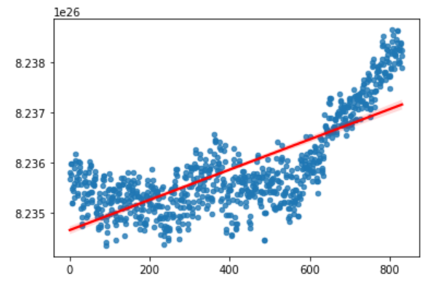

Confidence intervals
Global OHC (1950-2019)
Time

Slide 14
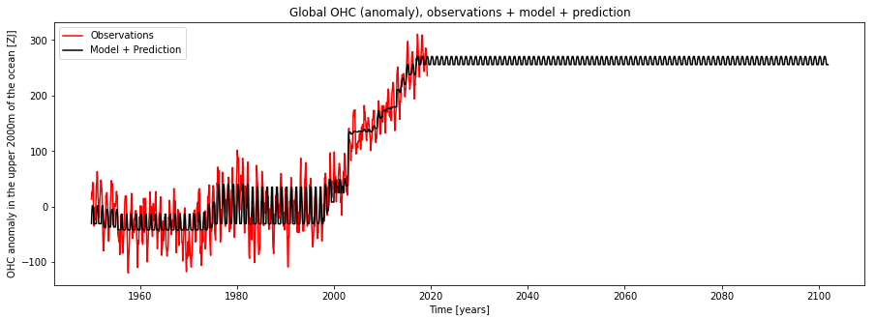
Adaboost regressor

Slide 15
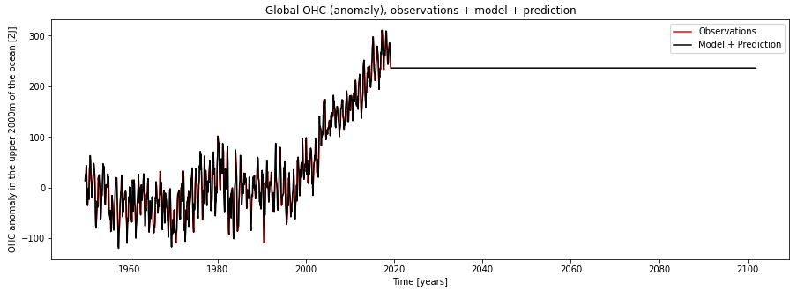
Random forest regressor

Slide 16
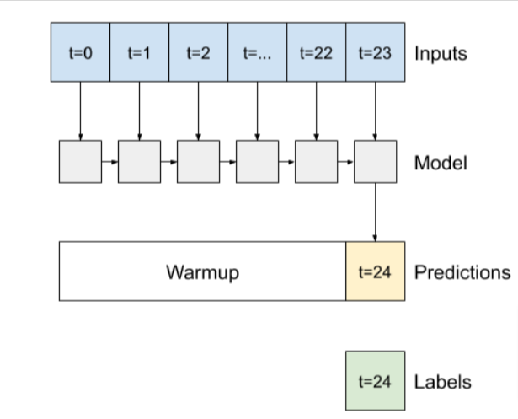
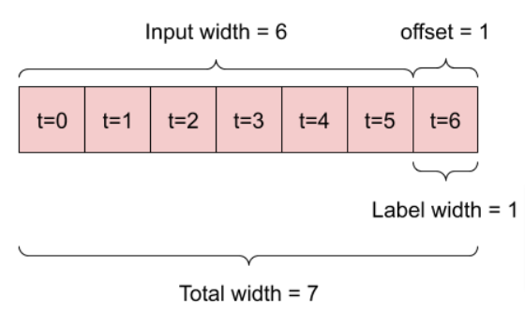
RNN Model

Slide 17
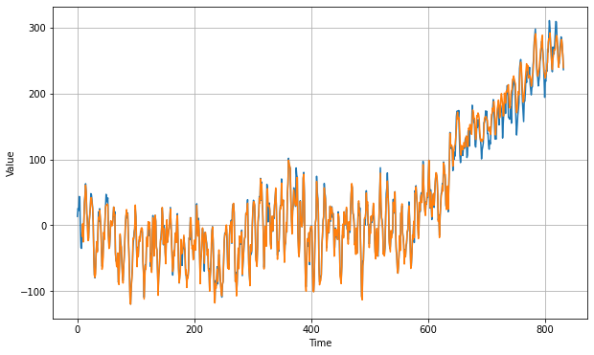
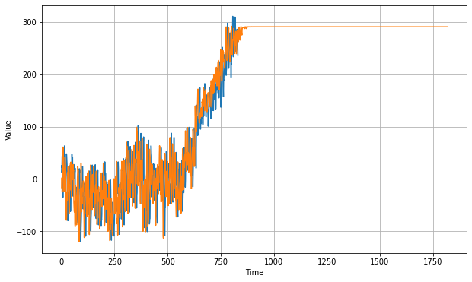
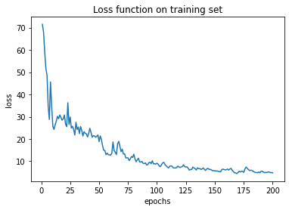
RNN approach

Slide 18

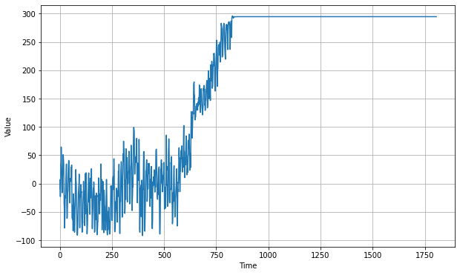
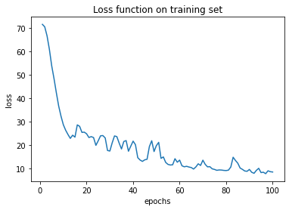
RNN approach

Slide 19
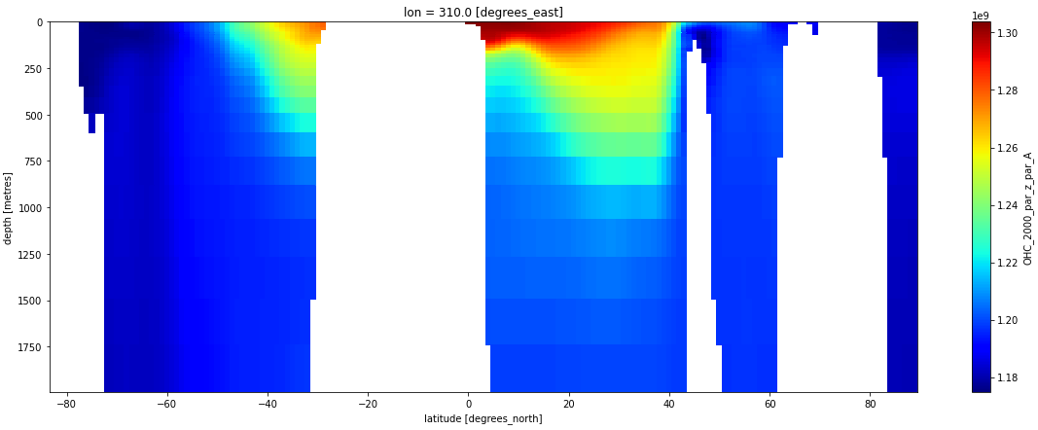

Locally
Mean OHC, for the years 1950-58, at lon=50W
Mean OHC, for the years 2010-18, at lon=50W

Slide 20
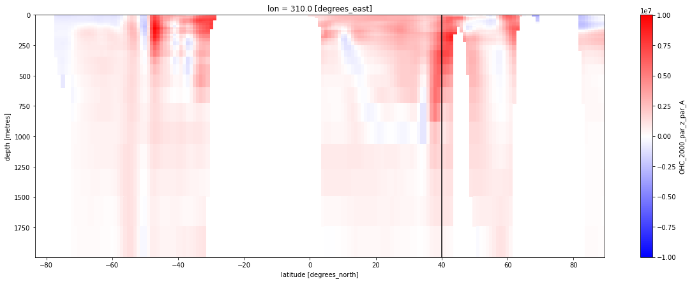
Locally
OHC difference between 2010-18 and 1950-58, at lon=50W

Slide 21
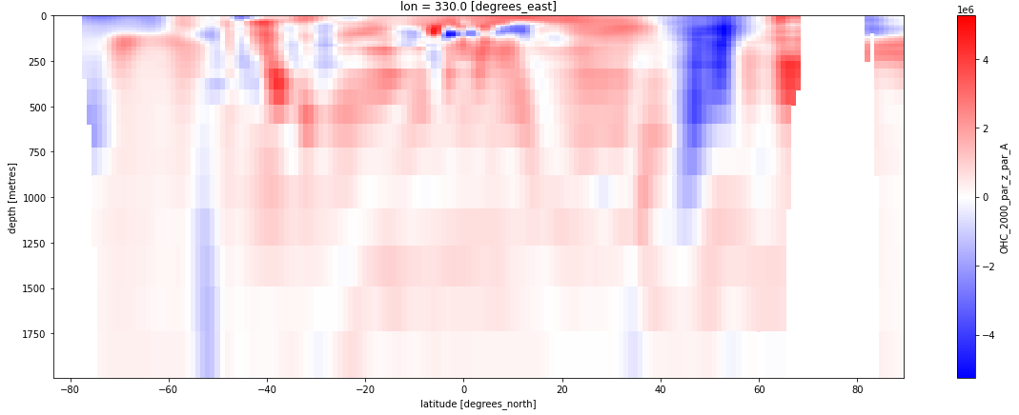
Locally
OHC difference between 2010-18 and 1950-58, at lon=30W

Slide 22
Conclusion
Linear Regression :
Global trend seems to be well represented
However, not very complex : local variations
Other models didn’t produce results and forecasts as expected.
The problem may be as follows:
Lack of sufficient information
Overfitting over the training examples
Too complex models for the forecasting task

